Slide 1


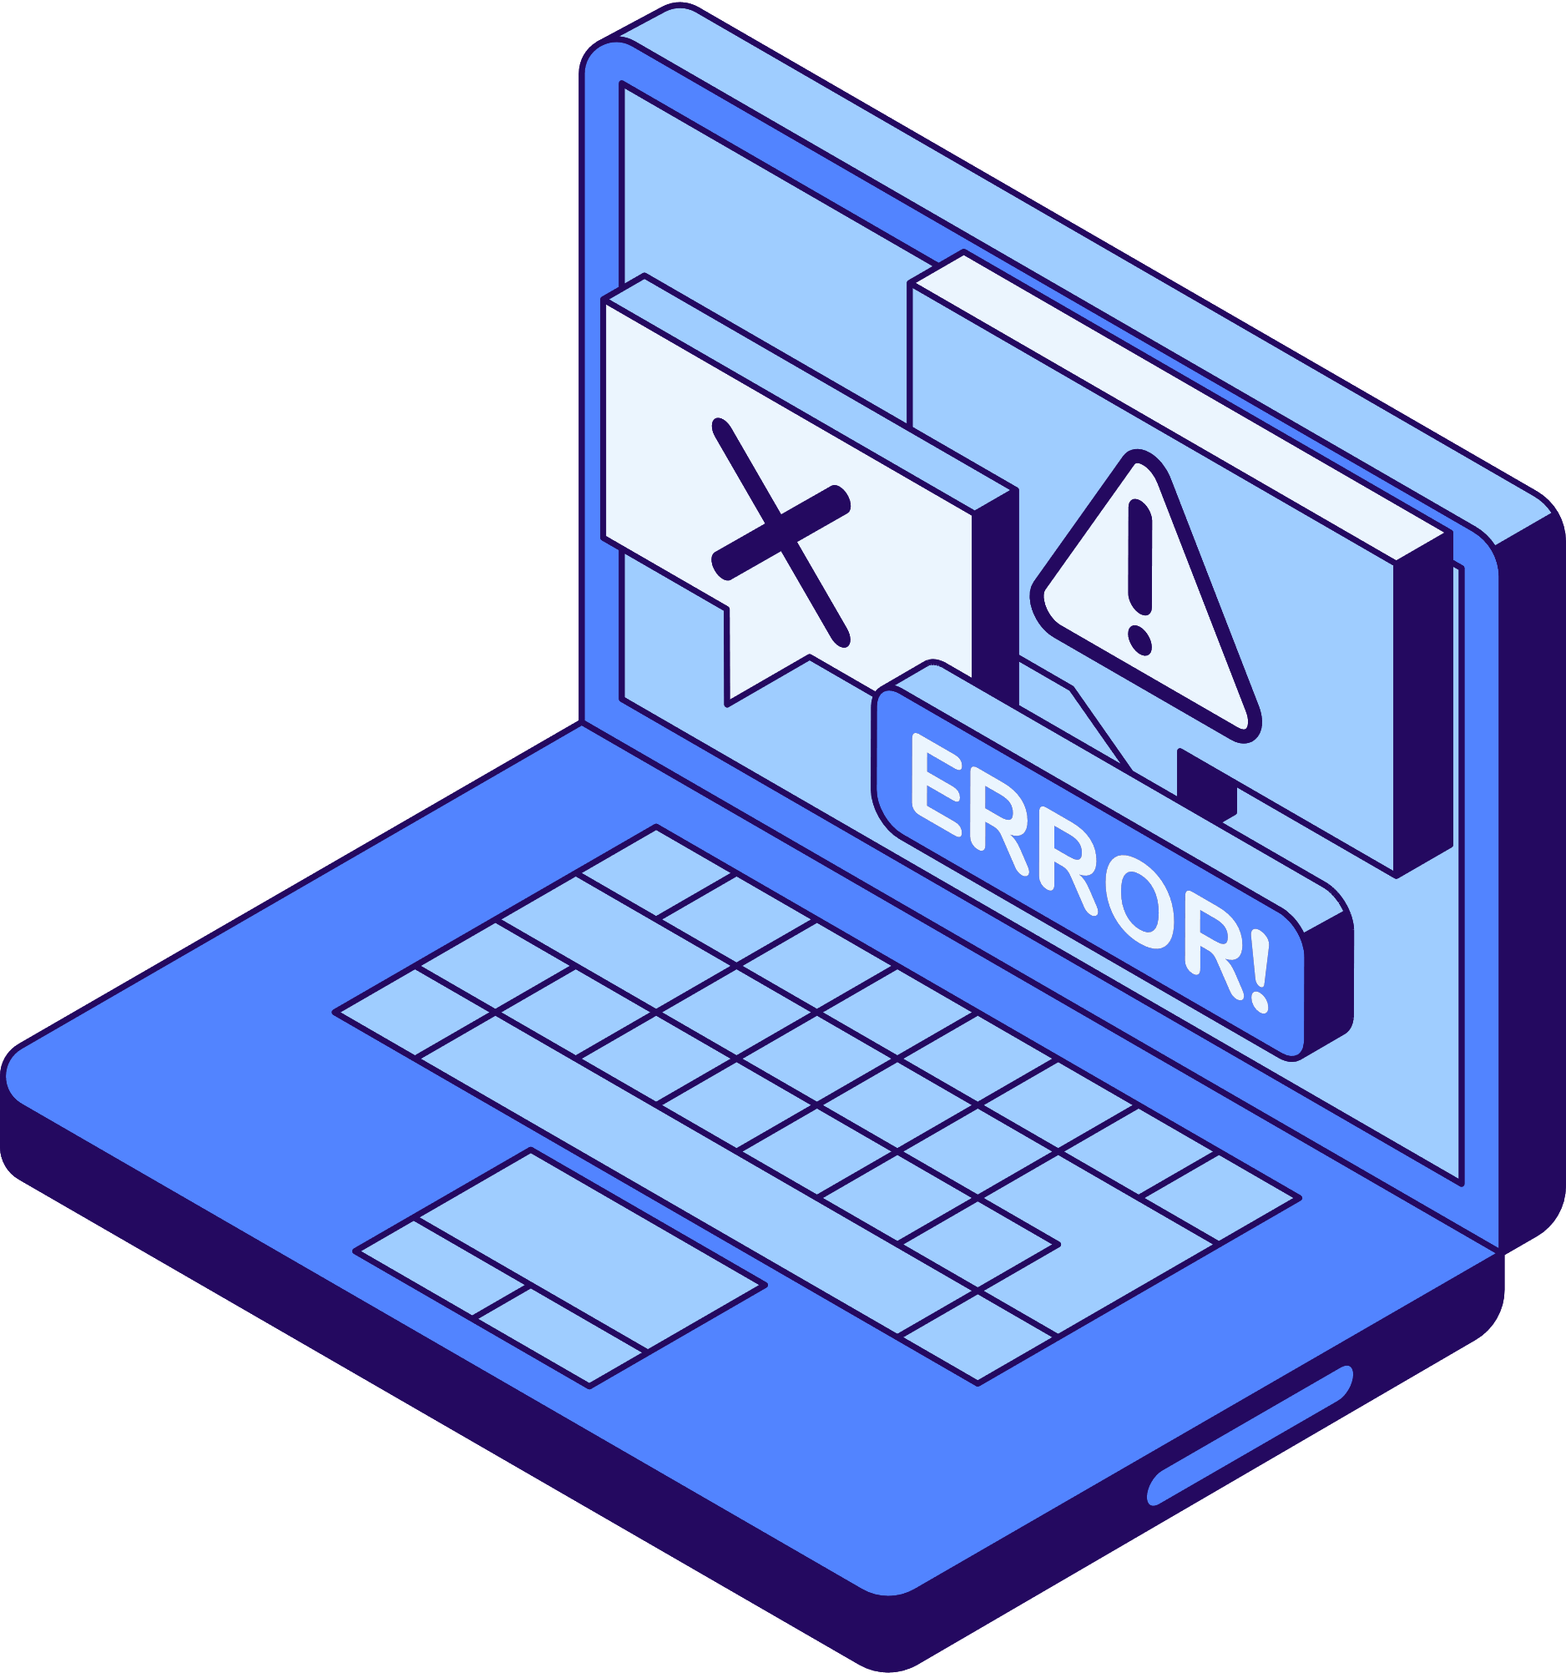


01/10
WIRE
Shark
Wabil Nadeem (052)
Abdullah (029)
Habiba Fiaz (021)
Safa Ghaffar (016)
Zahra Akhtar (045)
www.wireshark.org

Slide 2


02/10
Tool
Introduction
Network protocol analyzer.
Uses:
Packet capture
Deep traffic inspection.
Supports hundreds of protocols.
Essential for network diagnostics and security analysis.
Key Features:
Real-time packet capture.
Interface selection and fine-grained filtering

Slide 3



03/10
USE
CASES
SYN Flood Detection
HTTPS Decryption
ARP Poisoning

Slide 4


SYN
Flood Detection
04/10
Content:
Wireshark Role: Defensive
Scenario:
Attacker floods target with spoofed SYNs
Server never gets ACK = half-open connections
Filters Used:
SYN only packets: tcp.flags.syn == 1 && tcp.flags.ack == 0
Source IP: 10.0.0.1 – 10.0.0.255
ACK only packets: tcp.flags.syn == 0 && tcp.flags.ack == 1
Detection:
One-way SYNs with no replies

Slide 5

Decryption
05/10
HTTPS
Content:
Wireshark Role: Both Defensive and Offensive
Scenario:
Use browser’s SSL key log to decrypt HTTPS
Simulate attacker with access to session keys
Tools:
SSLKEYLOGFILE + Wireshark
Firefox or Chrome
Steps:
Visit login form site (e.g., the-internet.herokuapp.com)
Enable session key logging
Load keys in Wireshark > TLS
Result: Decrypted POST requests and headers

Slide 6

Content: OSI Layer: Data Link Layer (L2)
Wireshark Role: Defensive
Scenario: Detect ARP poisoning from PCAP
Steps:
- Filter: arp
- Filter ARP replies only: arp.opcode == 2
- Observe IP mapped to multiple MAC addresses
Indicators: Duplicate IP warning, MAC inconsistency
Confirmed: ARP spoofing using sample PCAP
06/10
ARP
Content:
Wireshark Role: Defensive
Scenario:
Detect ARP poisoning from PCAP
Indicators:
Duplicate MACs in ARP replies
Filters/Stats:
arp
arp.opcode==1
arp.opcode == 2
Check MAC inconsistencies
POISONING
DETECTION

Slide 7
07/10
OSI
LAYER MAPPING
DDOS Detection
HTTPS Decryption
ARP Poisoning
Transport Layer (L4)
Monitors TCP handshake
Application Layer (L7)
SSL/TLS decryption
Data Link Layer (L2)
Detects MAC address spoofing

Slide 8
08/10
MITRE ATT&CK
Mapping
DDOS Detection
HTTPS Decryption
ARP Poisoning
Impact
Direct Network Flood
T1498.001
Credential Access
Unsecured Credentials
T1552.004
Credential Access
ARP Cache Poisoning
T1200

Slide 9

09/10
MITIGATION
STRATEGIES
Restrict Wireshark usage to admin users
Implement Perfect Forward Secrecy
Monitor and log Wireshark usage in internal networks
Sanitize or encrypt PCAPs before sharing

Slide 10



10/10
CONTACTS
Police 15
Ambulance 1122
Child Protection 1121
Firefighting 16
Harassment Protection 1043
THANK
YOU!
Email: zakaat1980@gmail.com
www.MADAD.com

